Slide 1



Titolo presentazione sottotitolo
Design and Implementation of Mobile Application
WHERE AM I
AY 2019-2020
Design and Implementation of Mobile Application
Bianco Luca, matricola_1 Consonni Luca, 920040
Milano, XX mese 20XX
Bianco Luca 915240 Consonni Luca 920040

Slide 2
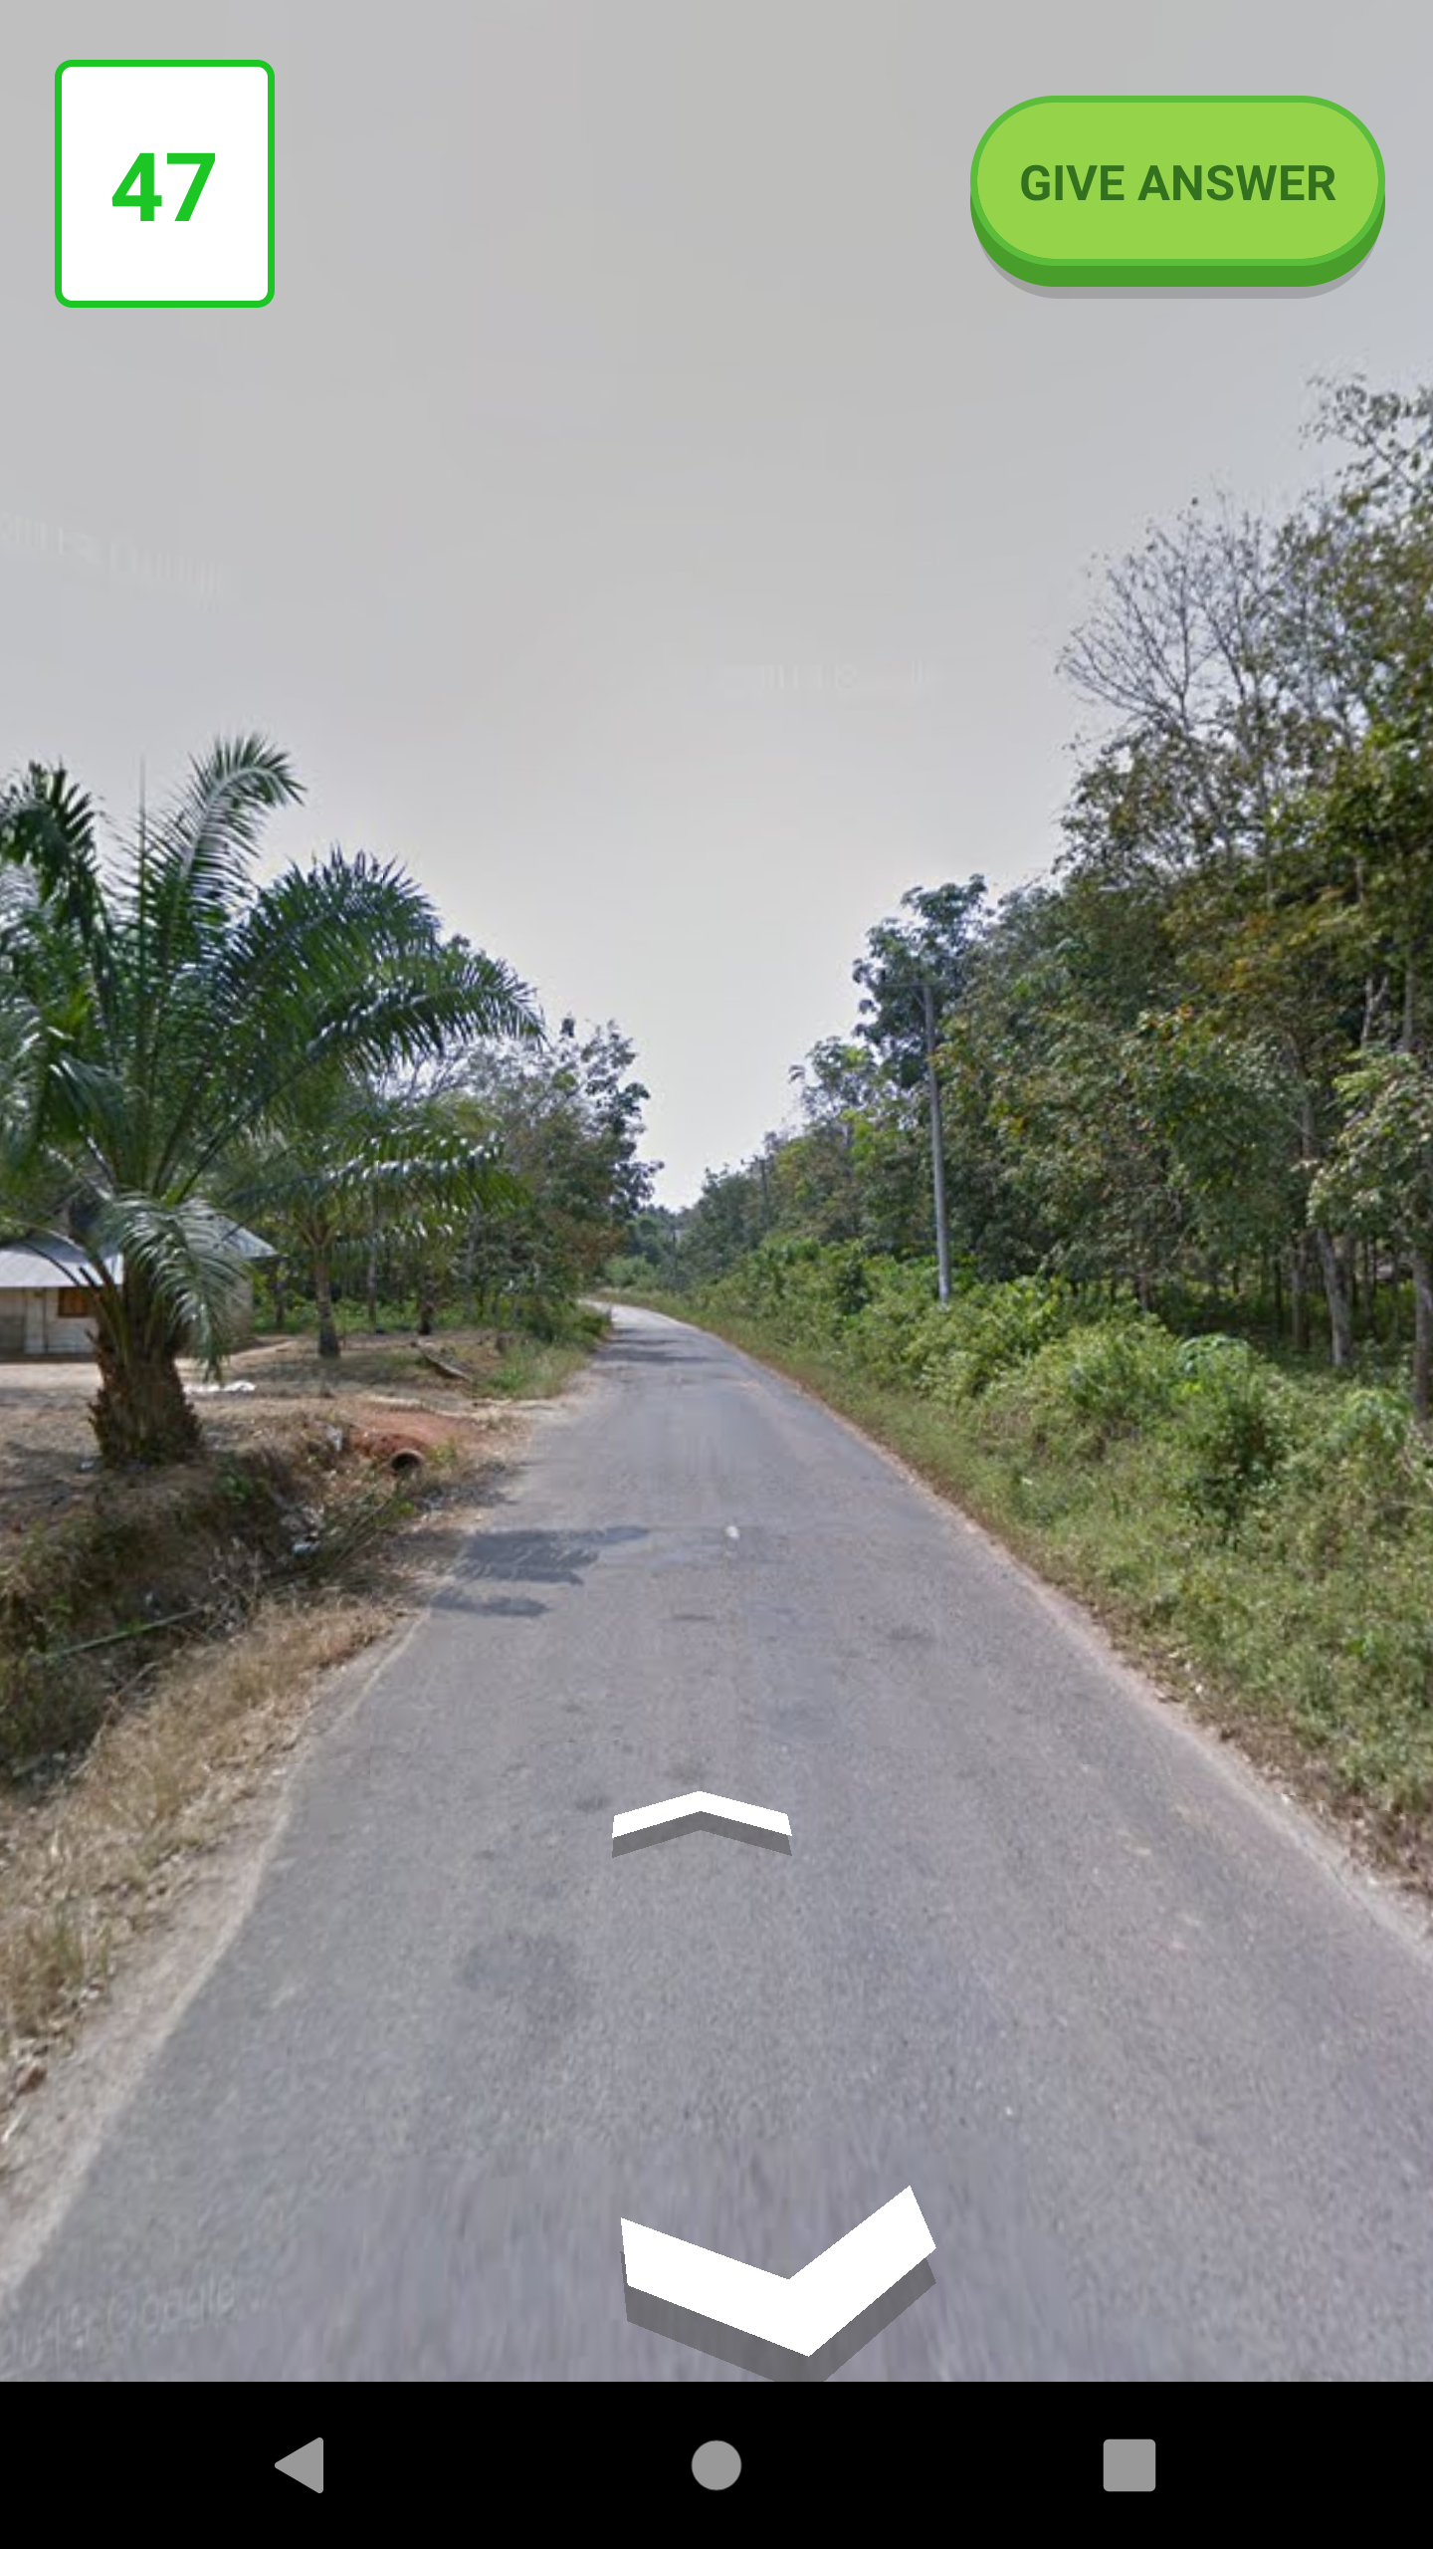
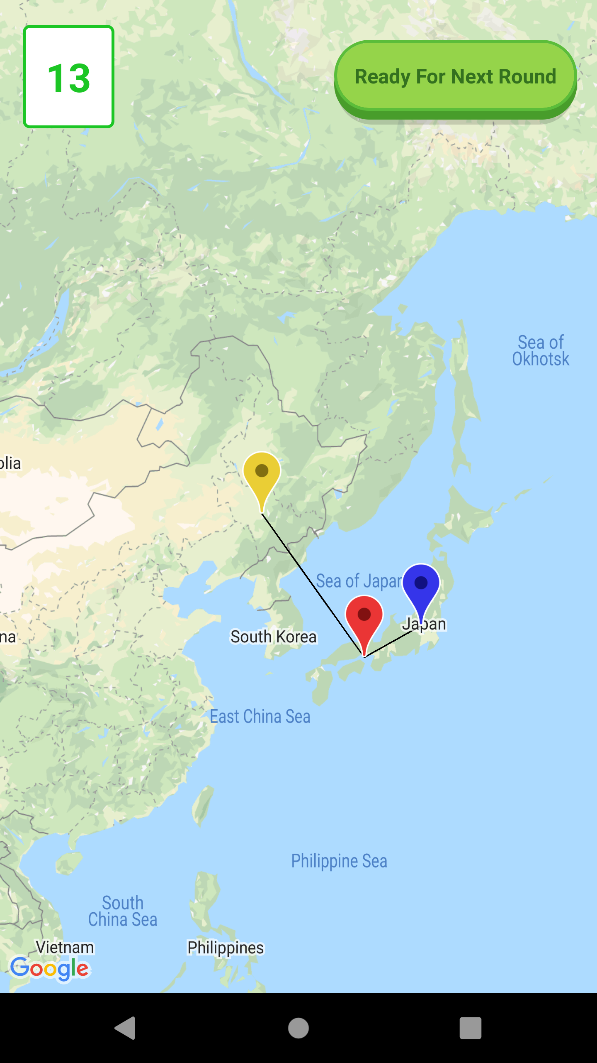
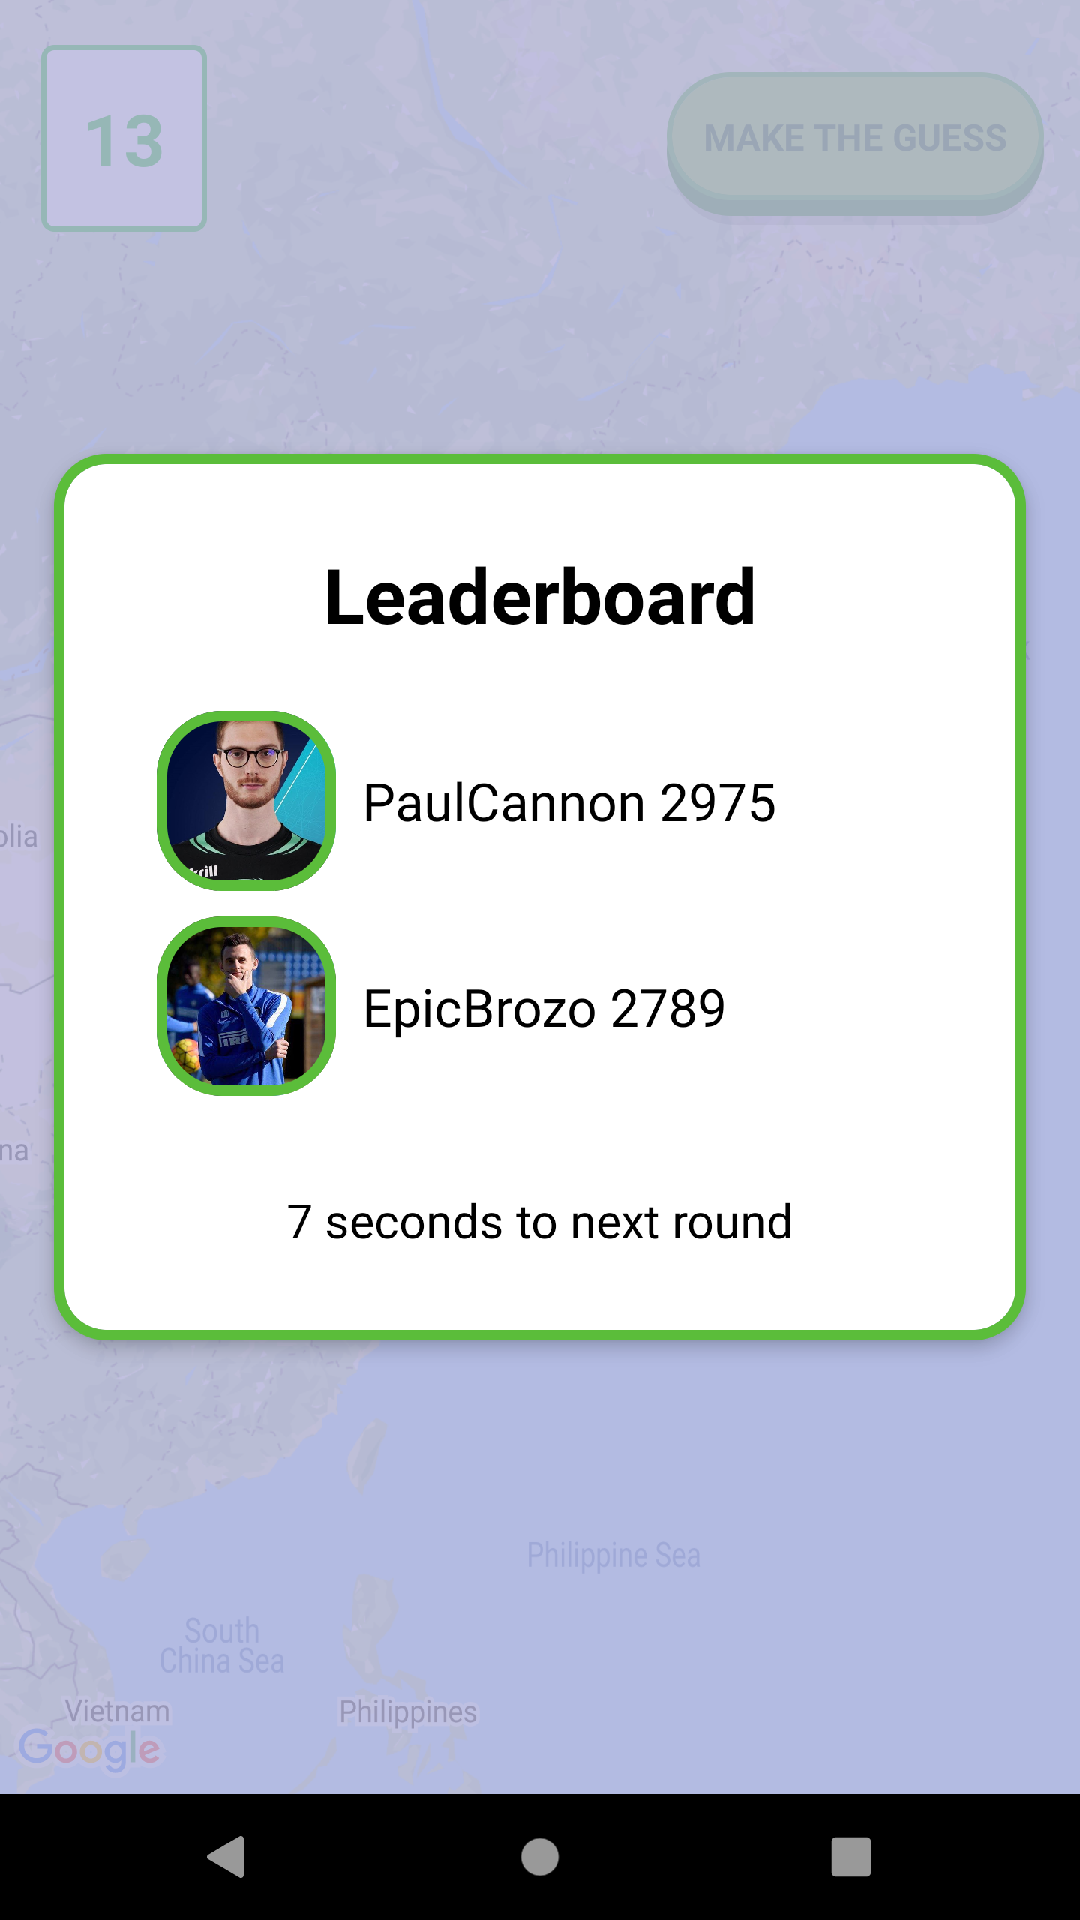

Choice and Introduction of Application – The Game
Where am I is a geography game which takes you on a journey around the world and challenges your ability to recognize your surroundings.
Bianco-Consonni Where Am I

Slide 3
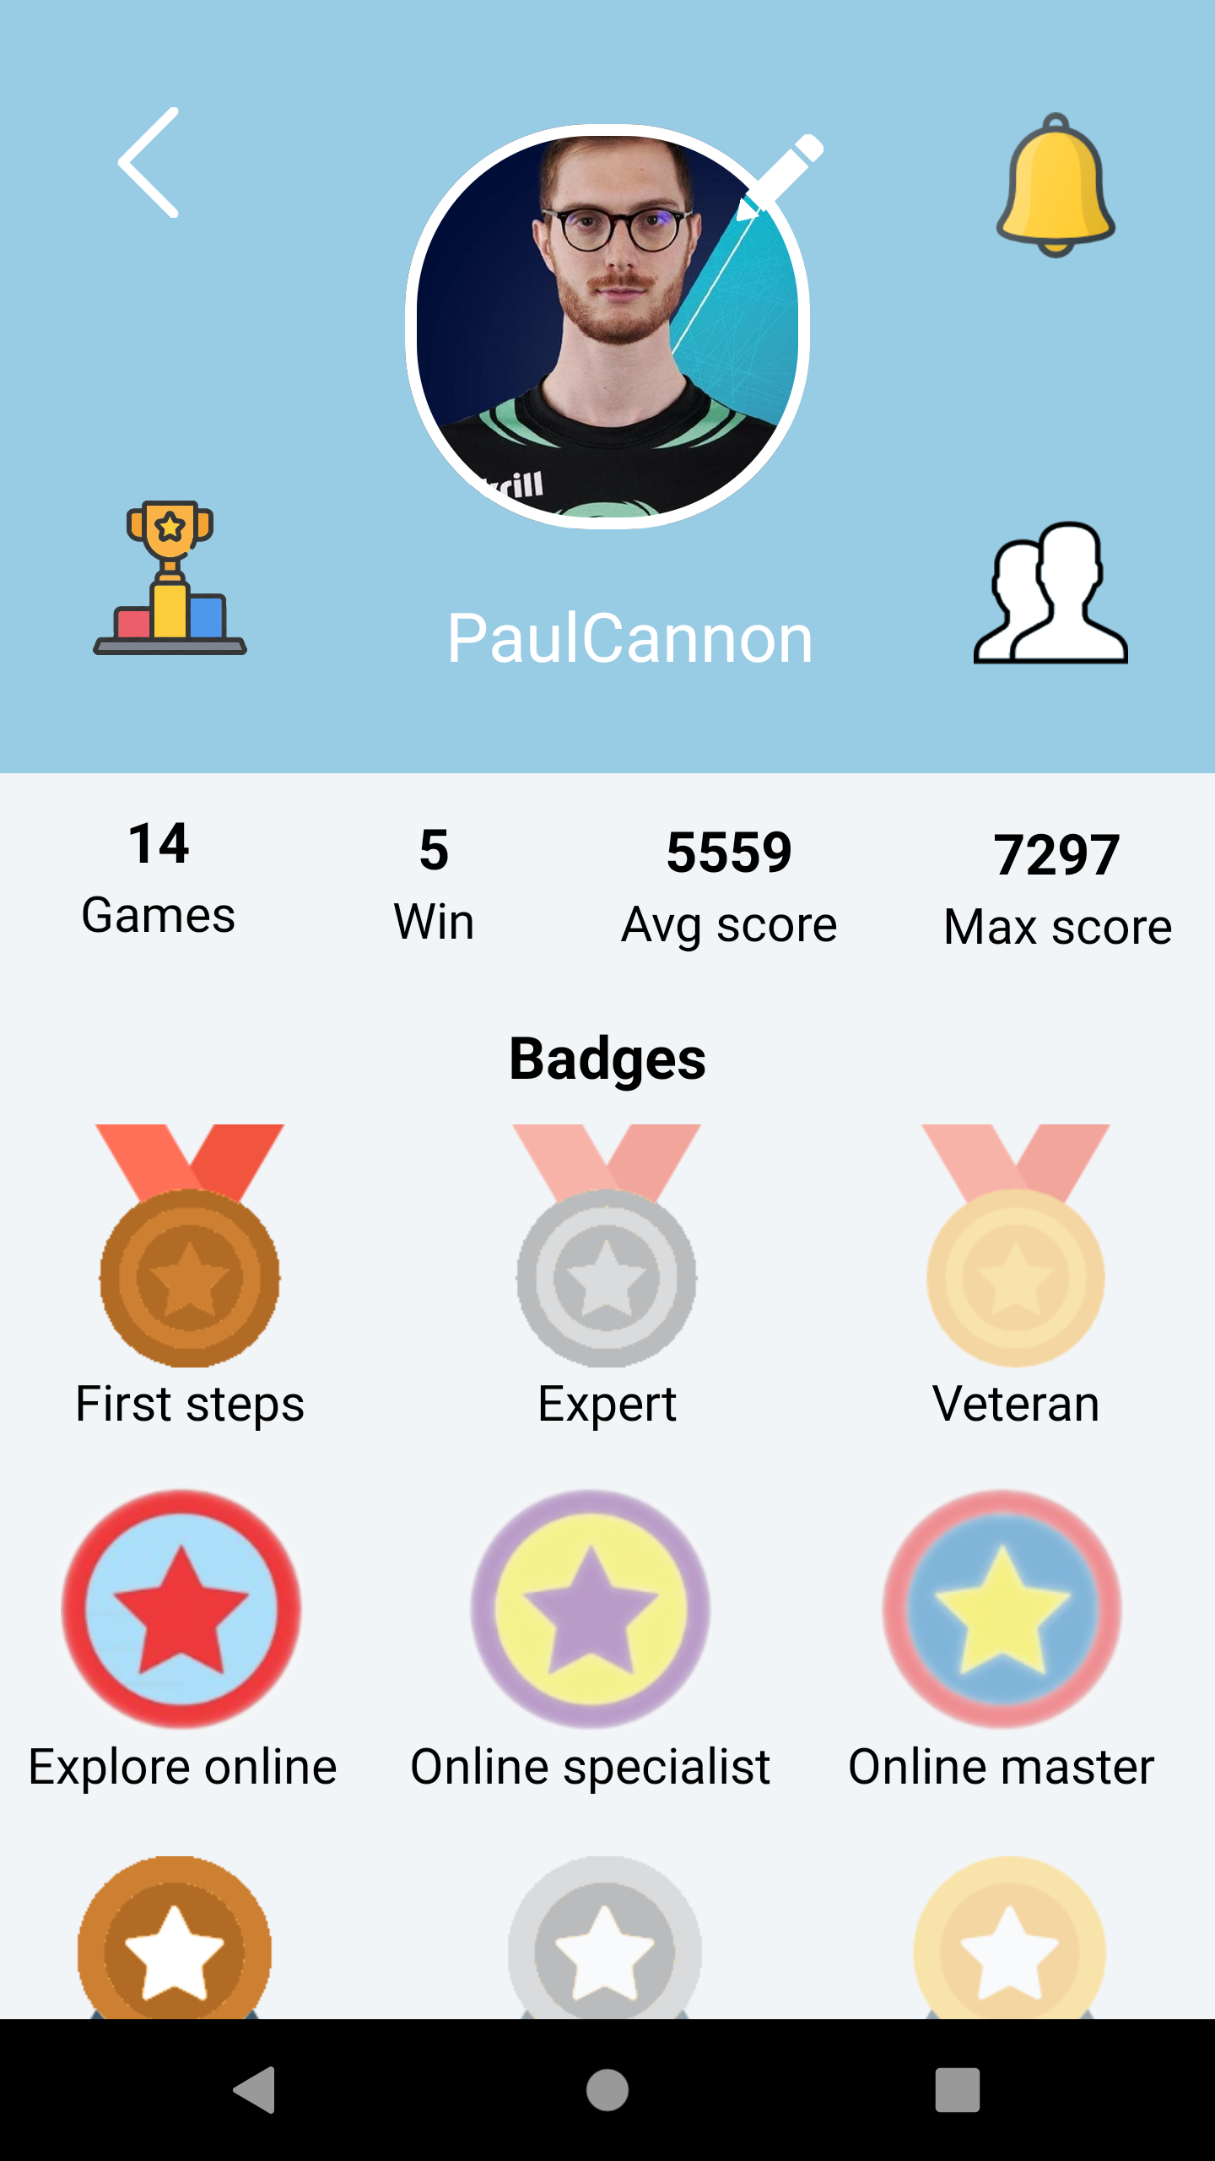
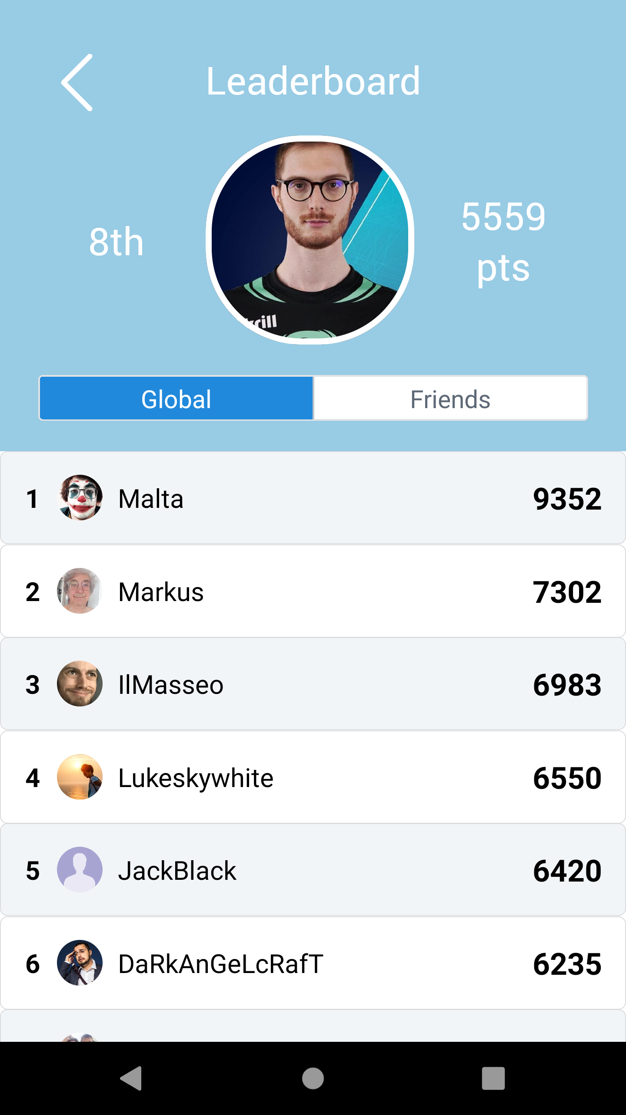
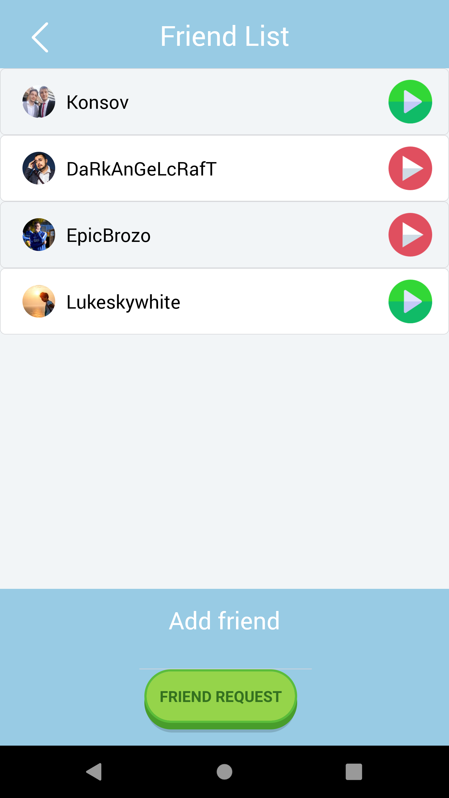
Choice and Introduction of Application – Social Experience
We decided to let game more desirable with a great social experience: ranking, reward system and friends
Bianco-Consonni Where Am I

Slide 4




Choice of the Language: React Native
One framework for Android and iOS
Learning a new Language
Large and increasing community
Bianco-Consonni Where Am I

Slide 5
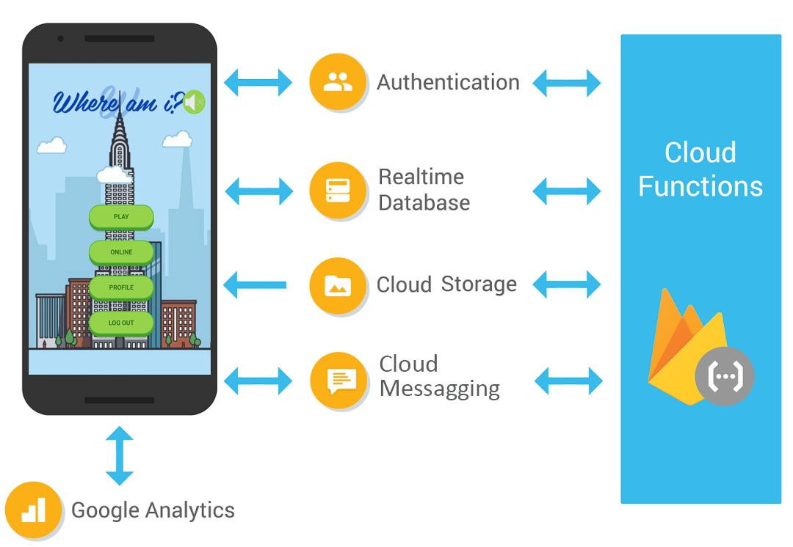


Architecture – Main External Services
Client – Server Architetcture but:
Game needs data synchronized in real time and with a traditional server
client-server application this process is very hard
Firebase and Google Cloud Platform, cloud platform that allows to build an application without managing the infrastructure.
Google Firebase
Google Maps Platform
Bianco-Consonni Where Am I

Slide 6
External Services - Firebase
Bianco-Consonni Where Am I

Slide 7
External Services - Firebase
This service is of fundamental importance since it handles all the authentication procedures for the users. It is used to allow user to
register or login using their preferred method among Facebook or classic email and password. Assign to each user a unique token.
This service handles the sending of messages from the server to the client. With this service we can handle notice of the application like: send request and badge of reward.
Cloud service used to store profile images uploaded by the user
Bianco-Consonni Where Am I

Slide 8
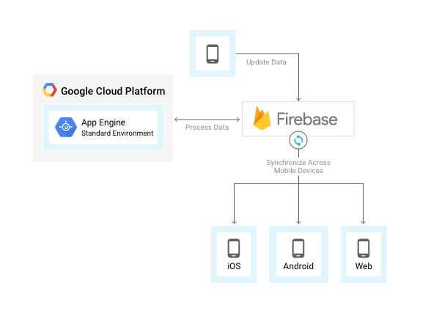
Firebase – Realtime Database
RealTime update data and synchronization across all device
NoSQL infrastracture
Nested JSON implemaentation
Bianco-Consonni Where Am I

Slide 9
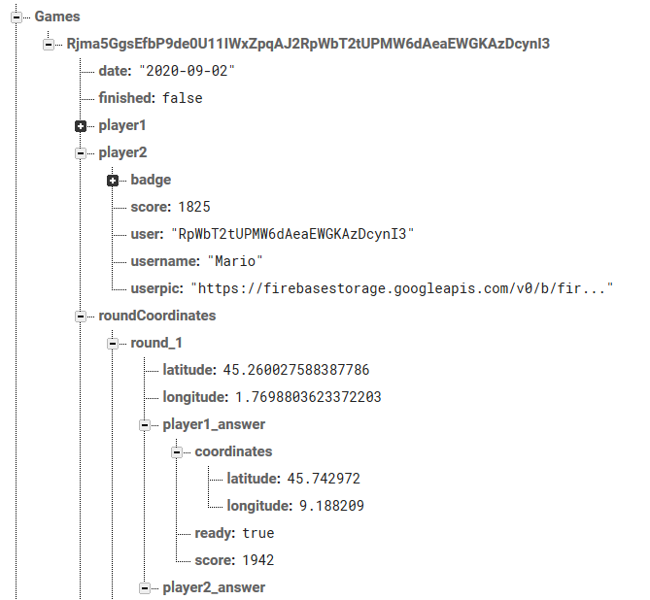
Firebase – Realtime Database
The Firebase Realtime Database is a cloud-hosted database. Data is stored as JSON and synchronized in realtime to every connected client. All user share one DB instance and automatically receive updates with the newest data.
Bianco-Consonni Where Am I

Slide 10
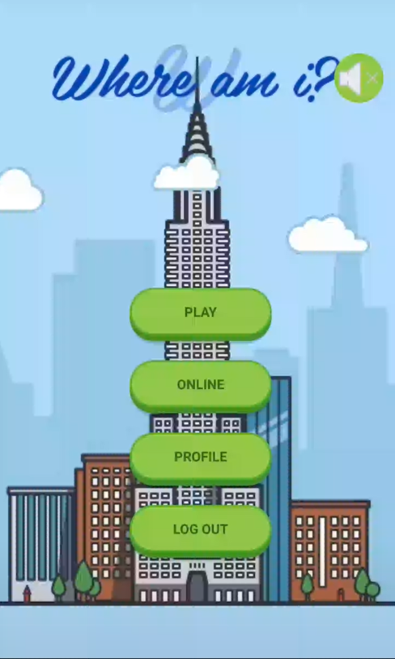
Firebase – Realtime Function Example, Front End
Homepage
Bianco-Consonni Where Am I

Slide 11
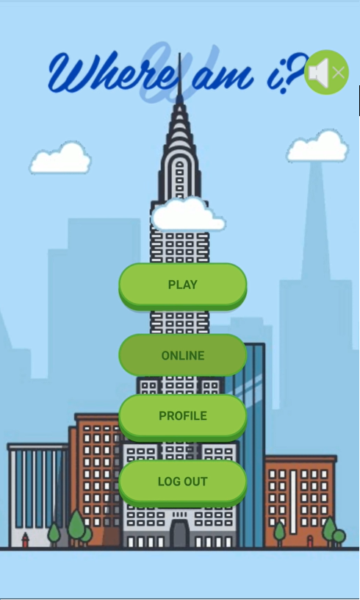
Firebase – Realtime Function example, Front End
Homepage
Press ‘Online’ button
Bianco-Consonni Where Am I

Slide 12

Firebase – Realtime Function example, Front End
Homepage
Press ‘Online’ button
Wait for an Opponent and loading of game
Bianco-Consonni Where Am I

Slide 13
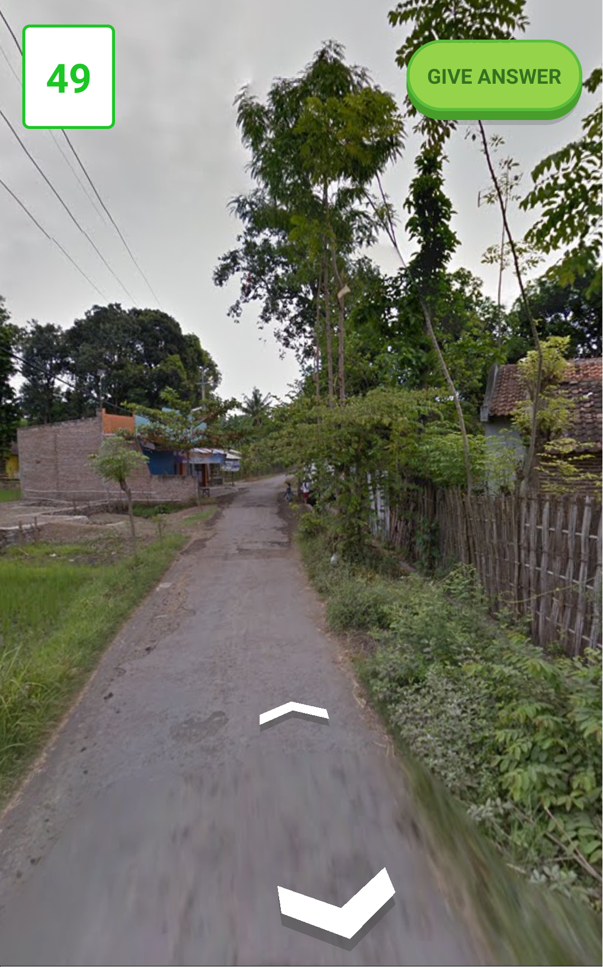
Firebase – Realtime Function example, Front End
Homepage
Press ‘Online’ button
Wait for an Opponent and loading of game data
Start the Game
Bianco-Consonni Where Am I

Slide 14
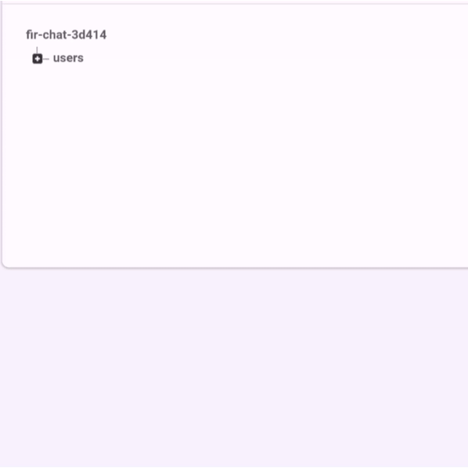
Firebase – Realtime Function example, Back End
At the first: no player are waiting for a new online game and none game is running.
Bianco-Consonni Where Am I

Slide 15
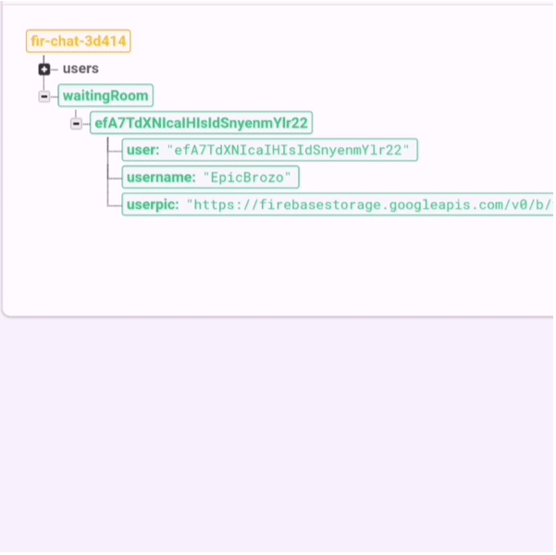
Firebase – Realtime database example, Front End
At the first: no player are waiting for a new online game and none game is running.
A Player press ‘Online’ buttuon
Bianco-Consonni Where Am I

Slide 16
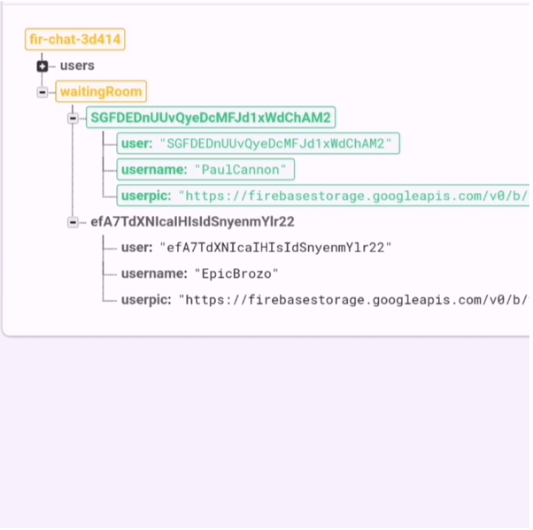
Firebase – Realtime database example, Front End
At the first: no player are waiting for a new online game and none game is running.
A Player press ‘Online’ button
An other player join the queque
Bianco-Consonni Where Am I

Slide 17
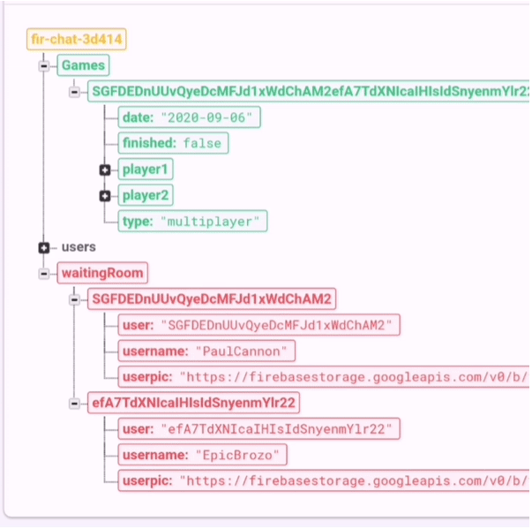
Firebase – Realtime database example, Front End
At the first: no player are waiting for a new online game and none game is running.
A Player press ‘Online’ button
An other player join the queque
When there are more than two players in waitingRoom, CreateRandomGame function create a new game.
Bianco-Consonni Where Am I

Slide 18
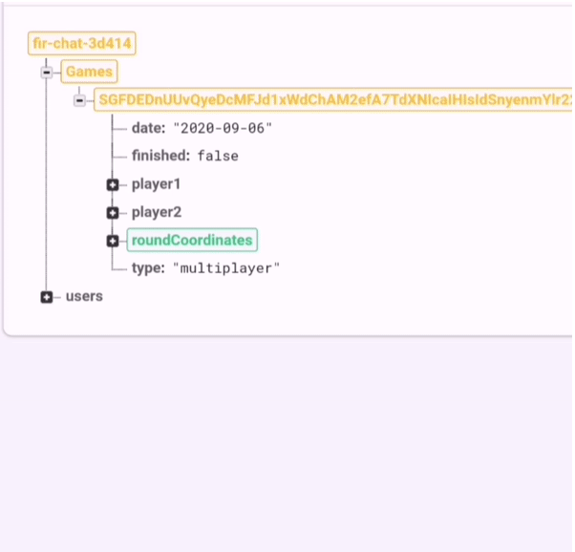
Firebase – Realtime Function example, Front End
At the first: no player are waiting for a new online game and none game is running.
A Player press ‘Online’ button
An other player join the queque
When there are more than two players in waitingRoom, CreateRandomGame function create a new game.
When there is a Game, the AddCoordinate function add the coordinates of the rounds
Bianco-Consonni Where Am I

Slide 19


External Service – Google Maps Platform
Best Street on the Market for:
Quality of the panorama
Coverage
Quality of Service
Maps
Streetview
Bianco-Consonni Where Am I

Slide 20
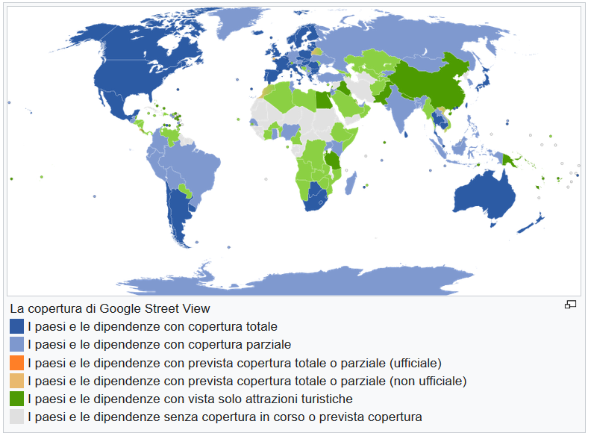
External Service – Google Street View
Bianco-Consonni Where Am I

Slide 21
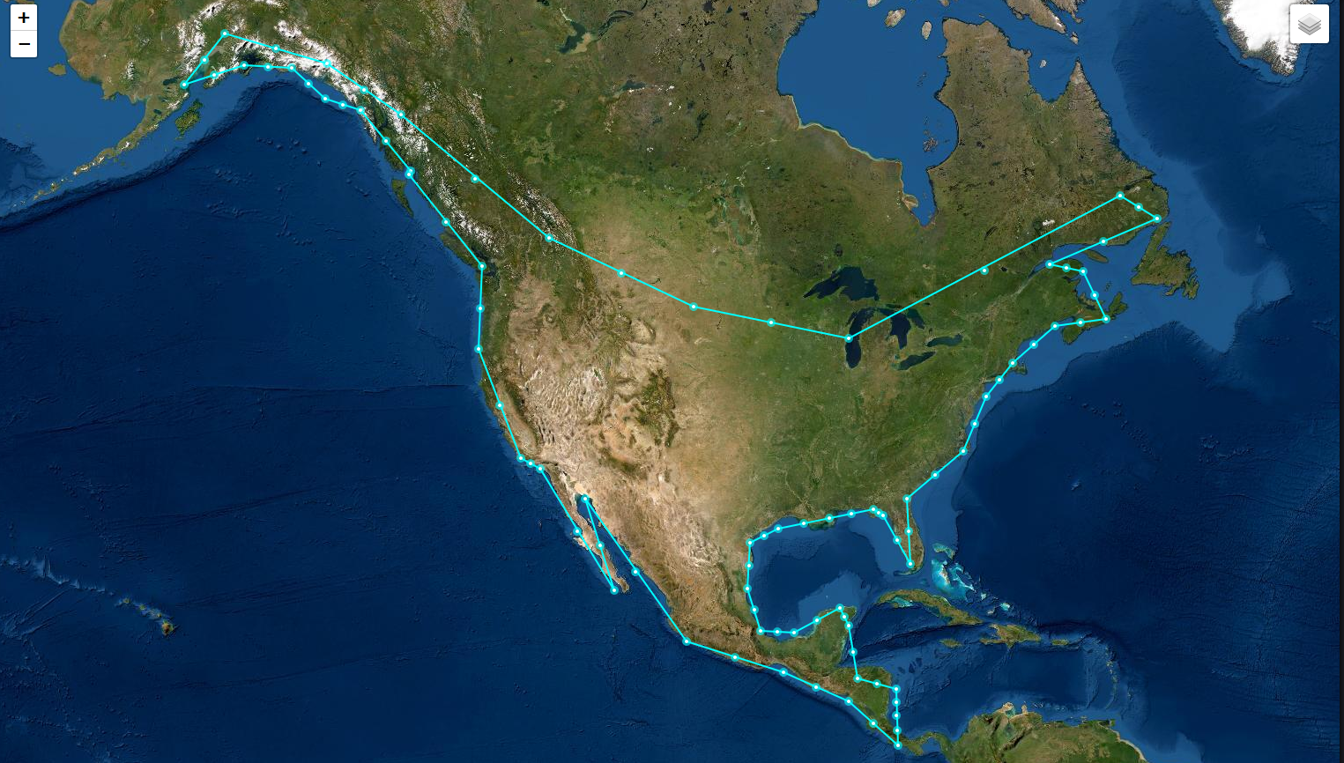
Development of Game – Random coordinates
World divided in Polygon:
To avoid not mapped coordinates
To avoid oceanic/desertic coordinates
Server-Side stored all continents polygon
Bianco-Consonni Where Am I

Slide 22
Let’s see a demo..

